Slide 1
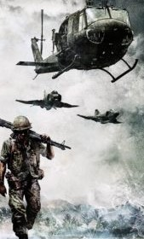
MATHEMATICAL
MODELING (MATH F240)
IRREGULAR WARFARE MODEL
Inspired by Lanchester Model

Slide 2
GROUP MEMBERS
Aditya Halli Arnav Gupta
Dhriti Nerurkar
Divyanshi Chouksey Mragansh Goel
Yashaswi Piplani
2020B4A81851G
2020B4A71980G
2020B4AA1907G
2020B4A71668G
2020B4A32035G
2020B4A31845G

Slide 3
CONTENTS
Introduction
Assumptions
Aimed-fire model
Area- fire model
Combined equations
Introducing reinforcements
Multilateral conflict
Technological advancement
Appendix

Slide 4
INTRODUCTION
Military operations apply mathematical models to analyze various military concepts. Recent War scenarios have been highly asymmetric. Such models are used to study the dynamics of the war and analyze the fate of such engagements.
Lancaster's theory is used as a basis while incorporating required changes like introducing various other parameters to make the model more practical and real-life based and are used by military analysts to study force structure and accordingly plan courses of action.
Lanchester equations are a system of Ordinary differential equations which describe the mutual attrition continuously occurring in time between two opposing forces in a violent engagement.

Slide 5
MATHEMATICAL MODELING OF IRREGULAR WARFARE
We start with identifying the variables. Time t is the independent variable.
We have considered two armies, Blue(B) and Red(R).
B(t) and R(t) represents the number of soldiers alive of the blue army and red army respectively at time t.
(For simplicity, we will be using B and R instead of B(t) and R(t) throughout the model.)

Slide 6
ASSUMPTIONS
We assumed that the population is homogeneous, that is every soldier is equally likely to be killed.
Relaxed visibility- There are no hidden soldiers.
Injuries don't affect the effectiveness of the armies, that is a soldier is either dead or fighting.
All soldiers have equal potential.
Natural deaths are negligible as compared to war casualties.

Slide 7
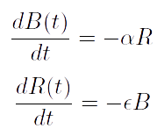


AIMED- FIRE MODEL
The Governing Equations Are
Where and are the killing rates of R and B respectively
In this model, each soldier will aim and kill members of the opposing force . This model is used where the battle comprises of one on one combat .
Here the attrition is fixed and the size of the opposing army doesn't matter.

Slide 8
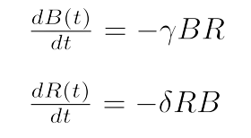
AREA- FIRE MODEL
The Governing Equations Are
Where γ is the kill rate of R when R fires in the area containing B's Forces and vice-versa.
Here the killing is proportional to both the size of the opposing army as well as their own army.
This type of model is applicable when an army fires in an unaimed manner or uses weapons with limited aim.

Slide 9
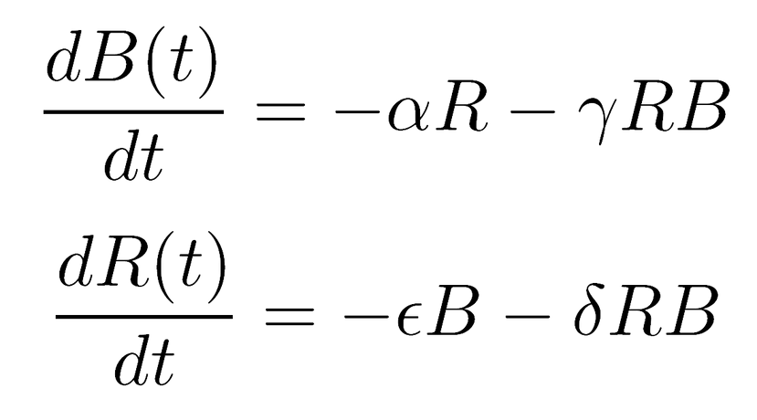
LANCHESTER COMBINED EQUATIONS
A real battle is likely to contain aspects of both the above stated models. Since the force will be depleted because of both aimed and unaimed firing aspects. So this gives rise to a combined model-

Slide 10
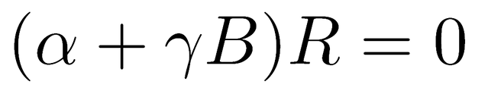
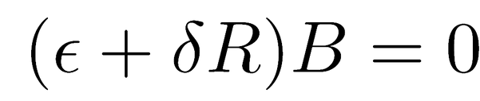
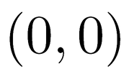
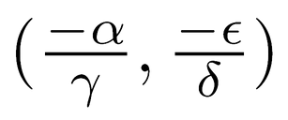
STABILITY ANALYSIS OF LANCHESTER COMBINED EQUATIONS
Fixed points:
and
Upon solving we get and as the fixed points
Here, is physically insignificant as R and B both should be greater than or equal to zero.
Hence, is the only fixed point here.

Slide 11
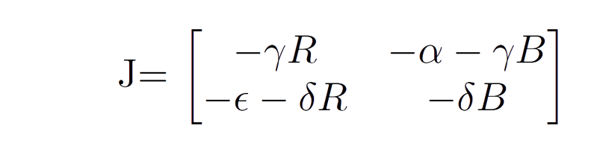

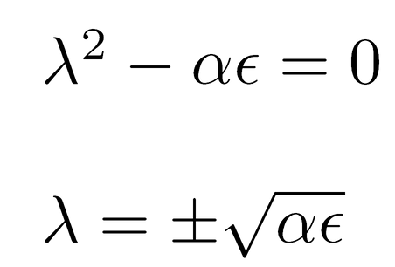
STABILITY ANALYSIS OF LANCHESTER COMBINED EQUATIONS
The characteristic equation of the above Jacobian is obtained as below:
From the eigenvalues we can see (0,0) will be a saddle point.

Slide 12
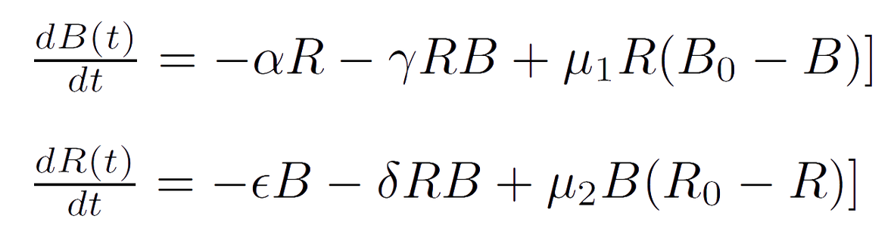


INTRODUCING REINFORCEMENTS
In a practical scenario there definitely would be reinforcements for both armies, technological advancements too are possible, or maybe even there are three different armies involved in the war.
By taking these into consideration, we move ahead first, with the addition of reinforcements
Reinforcements in B's Army

Slide 13
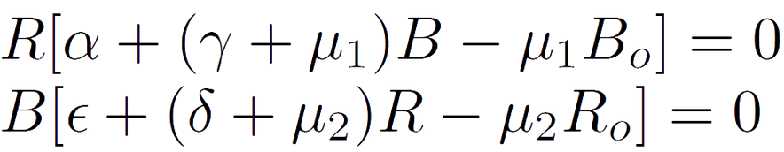



INTRODUCING REINFORCEMENTS
Fixed points for the equations are obtained as below:
=
Now, if R=0 , then either B= 0 or
Now, if B=0 , then either R= 0 or

Slide 14

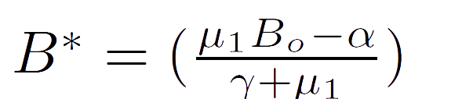





INTRODUCING REINFORCEMENTS
If R B 0,
and
and
for B* to exist ,
for R* to exist.
So, the fixed points are
and

Slide 15
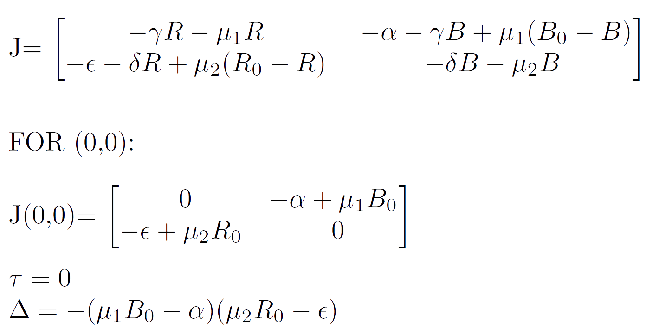
STABILITY ANALYSIS

Slide 16
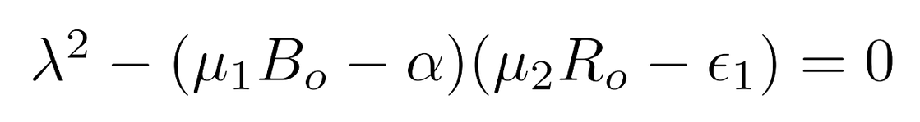
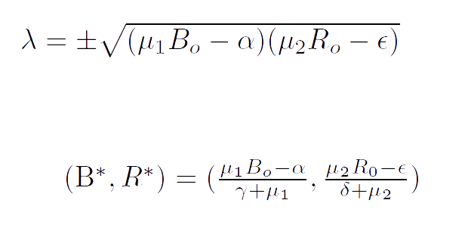
STABILITY ANALYSIS
CHARACTERSTIC EQUATION
Therefore, (0,0) will be a saddle point.

Slide 17
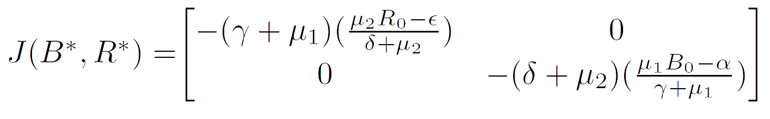




STABILITY ANALYSIS
as μ2Ro > ϵ
as μ1Bo > α

Slide 18
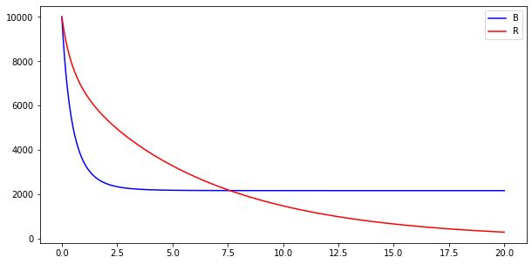






GRAPHS FOR REINFORCEMENTS
Number of Soldiers
(B*,R*)=(2173.9, 0)
Number of days
=0.3
=0.000003
=0.00015
=0.00008
=0.7
=0.00007
All the parameters are with respect to the number of days

Slide 19
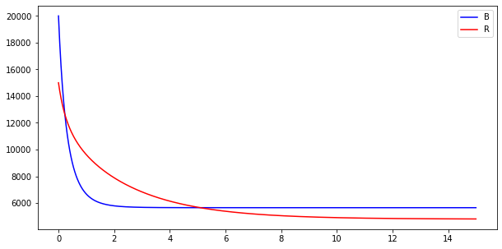
GRAPHS FOR REINFORCEMENTS
Number of Soldiers
(B*,R*)=(5652.2, 4794.5)
Number of days
=0.3
=0.000003
=0.00015
=0.7
=0.00007
All the parameters are with respect to the number of days
=0.00008

Slide 20
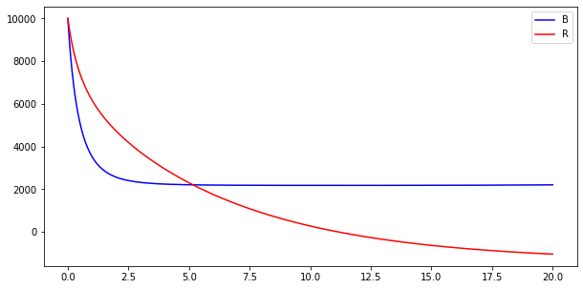
GRAPHS FOR REINFORCEMENTS
Number of Soldiers
(B*,R*)=(2173.9, -1369.8)
Number of days
=0.3
=0.000003
=0.00015
=0.8
=0.00007
All the parameters are with respect to the number of days
=0.00008

Slide 21
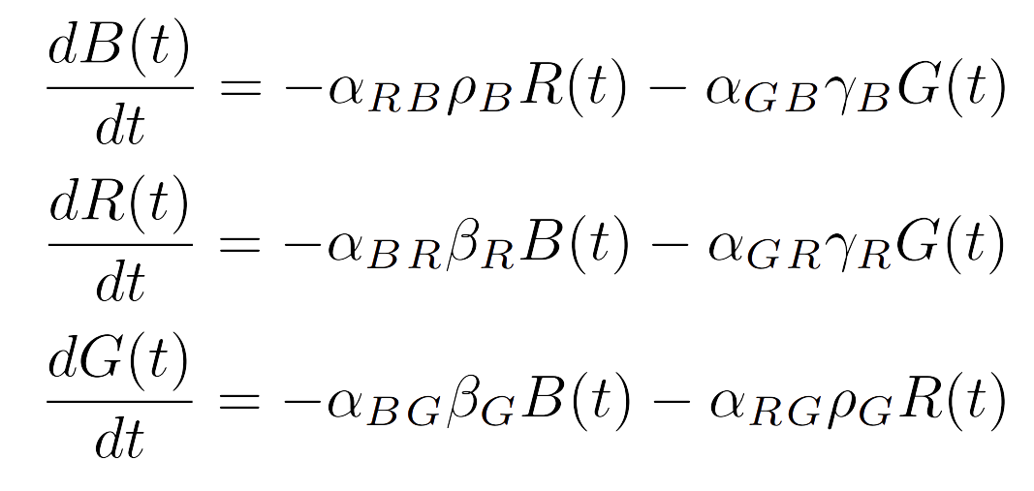
MULTILATERAL CONFLICTS
The profound difference between two and multiple armies conflict is that in the case of a two army war, we simply capture the attrition on both sides as a function of their initial strengths and their attrition rates of them.
However, in a multiple or rather in a three army conflict, each army has to decide how to allocate its strength among the other adversaries so as to maximize its own chances to be the victor.

Slide 22
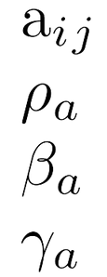
MULTILATERAL CONFLICTS
Where,
is the fraction of standing force of army i directed against army j is the kill rate of Red against a
is the kill rate of Blue against a is the kill rate of Green against a

Slide 23
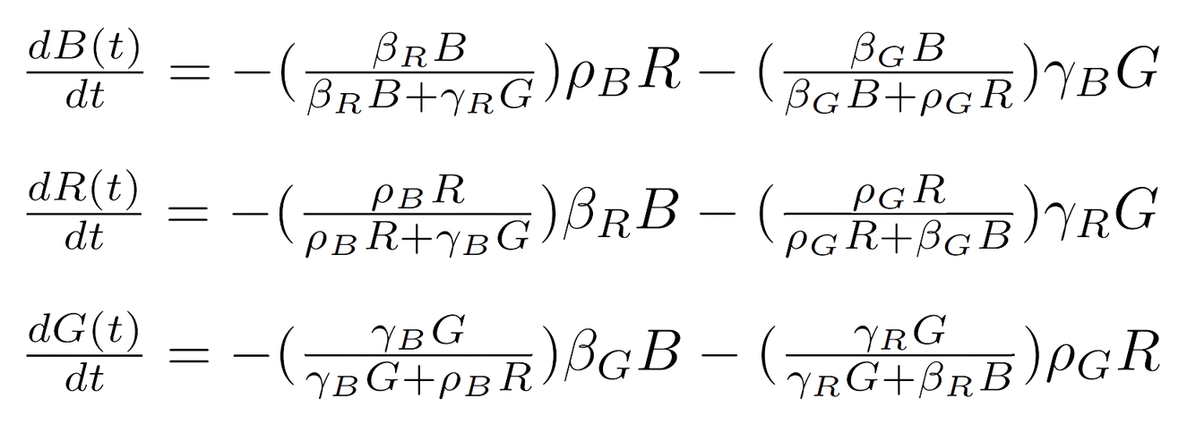
MODIFIED TRILATERAL CONFLICT
We henceforth take the special case wherein a particular army distributes its forces based on the fact that they are dominating over a particular army and hence it would be a viable option to transfer some quantity of its troops and direct them to face the other army. The differential equations would then look like :

Slide 24
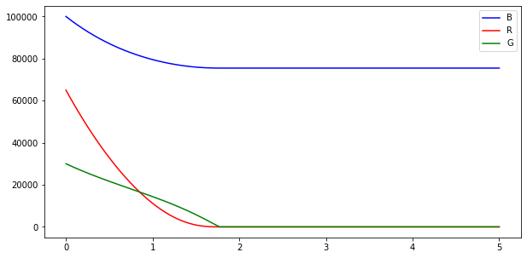






MODIFIED TRILATERAL CONFLICT
Number of Soldiers
Number of Months
= 0.8
= 0.4
= 0.3
= 0.6
= 0.55
= 0.7

Slide 25
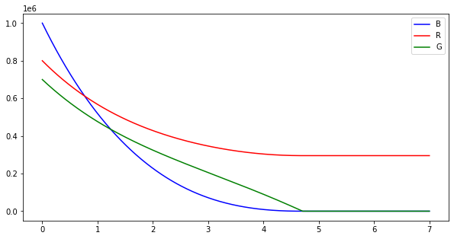
MODIFIED TRILATERAL CONFLICT
Number of Soldiers
Number of Months
= 0.35
= 0.45
= 0.4
= 0.75
= 0.55
= 0.25

Slide 26
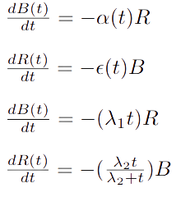
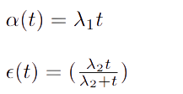
AIMED FIRE MODEL WITH
TECHNOLOGICAL ADVANCEMENTS
In case of a long drawn war, the technological advancements if taken into consideration can turn out to be a major factor in the war. Owing to tech advancements, attrition rate will become a function of time and we have taken different cases of attrition rates depending on time t such as linear dependance.

Slide 27
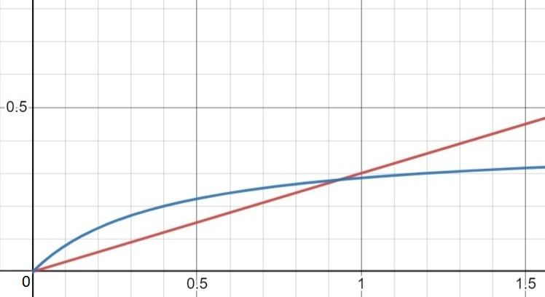
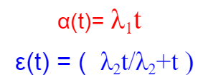
AIMED FIRE MODEL WITH
TECHNOLOGICAL ADVANCEMENTS

Slide 28
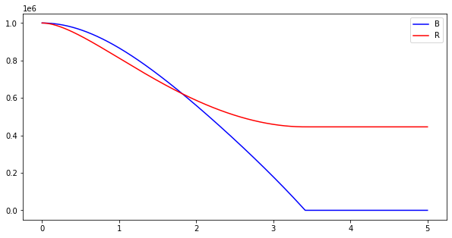


AIMED FIRE MODEL WITH
TECHNOLOGICAL ADVANCEMENTS
Number of Soldiers
Number of Years
= 0.4
= 0.3

Slide 29

APPENDIX
Python Graph Codes Research Paper I Research Paper II

